Slide 1

Analysis of Board Games
Davide Carrara
Francesco Romeo
NONPARAMETRIC
STATISTICS

Slide 2
Overview of the project
Dataset coming from BoardGameGeek, the most complete data source for board games.
Data regarding 21631 games, including info from BGG Marketplace
Estimate the complexity of a game
Predict the average user rating on BoardGameGeek leaderboard

Slide 3
Main features
Complexity of the game evaluated by users
Category of the game: setting and main dynamics
Mechanic: how the game is physically played
Ratings provided by users on BoardGameGeek: average, number of reviews
Players information: minimum and maximum number, minimum age
Average playing time indicated by the producer
Appeal: number of users owning the game or wanting it

Slide 4
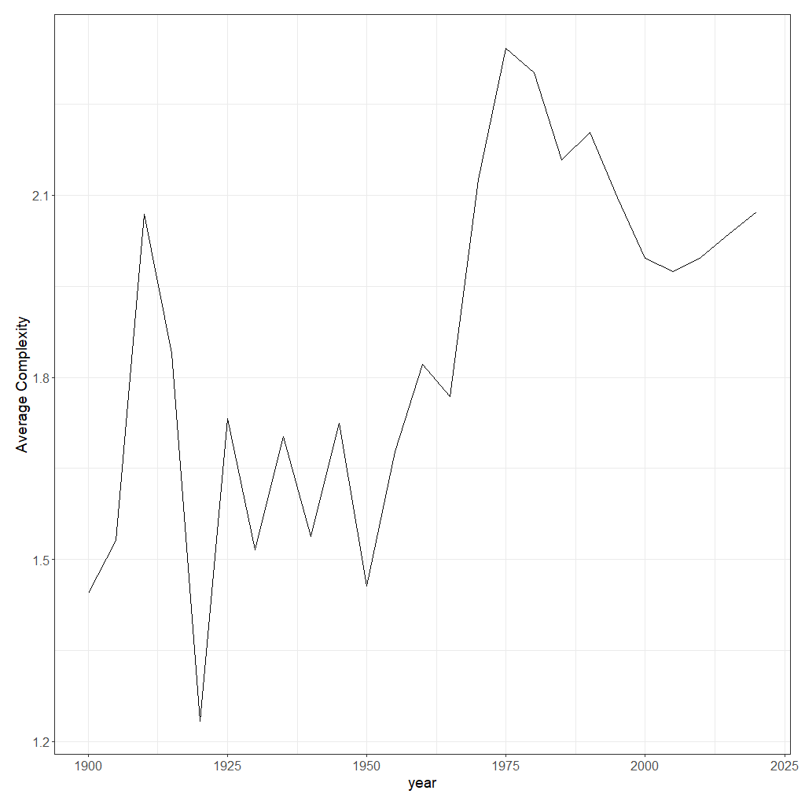
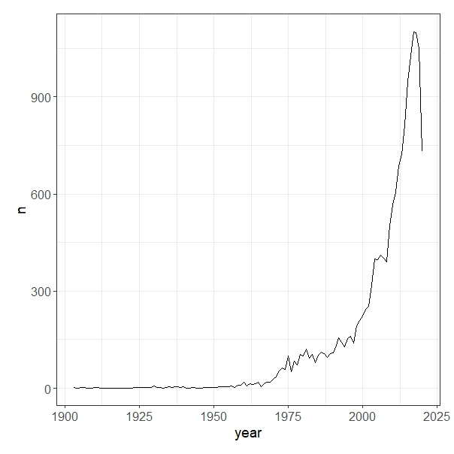
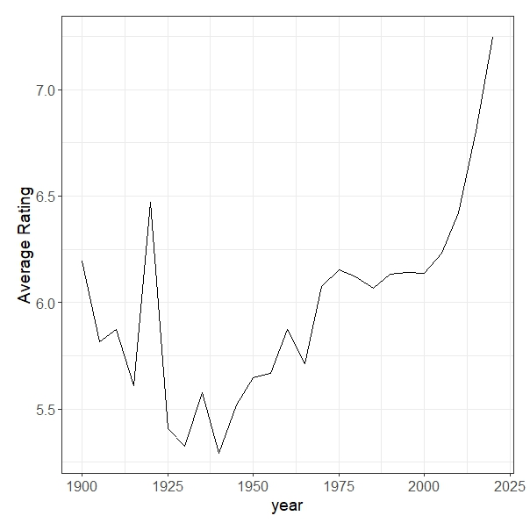
Evolution over time
Average complexity
Number of games
published
Average user rating

Slide 5
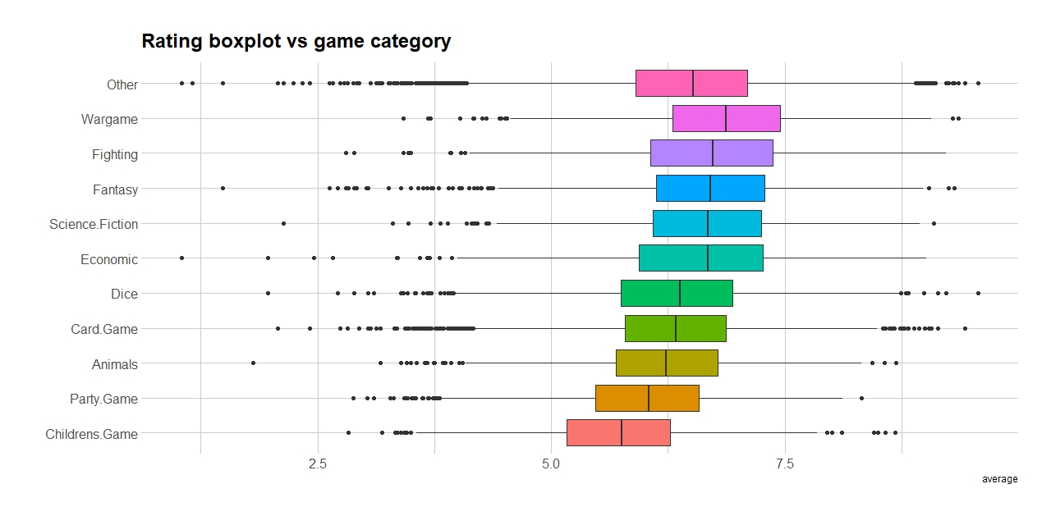
Categories and Average
Categories seem to have an effect on the average rating

Slide 6
Robust
Analysis
Couple Biased
Random Walks
Minimum Covariance Determinant
Outlier detection technique
for categorical features
Outlier detection and joint location-scatter estimator for numerical features
K-Medoids
Clustering
Robust clustering method based on categorical features

Slide 7
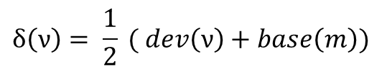

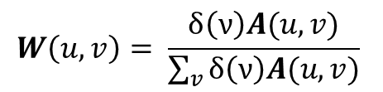
CBRW
Algorithm
06
Compute feature relevance and
point outlierness
Consider both intra-feature and inter-feature couplings in order to detect outliers
05
Value outlierness score $π^{∗}(v)$
04
Build the transition matrix
and simulate random walk
$$W\left(u,v\right)= \frac{δ\left(ν\right)A(u,v)}{\sum_{v}{δ\left(ν\right)A(u,v)}}$$
03
Compute edge weight $A\left(u,v\right)=p(u|v)$
02
Assign to each node its
intra-feature outlierness
$$δ\left(ν\right)= \frac{1}{2} ( dev\left(ν\right)+base\left(m\right))$$
01
Map the categorical data into a weighted graph: each feature value is a node

Slide 8
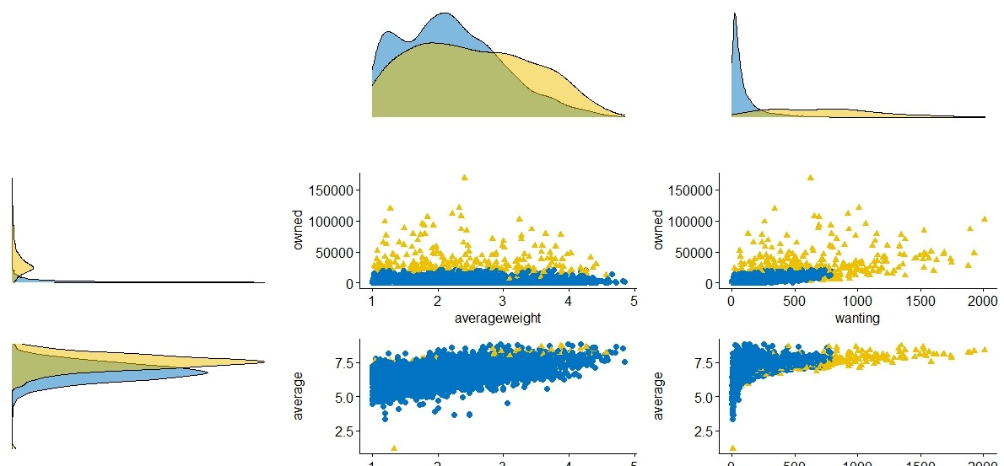
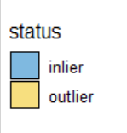
MCD – Minimum Covariance Determinant
Robust estimation for average, complexity and appeal terms – α = 0.95

Slide 9
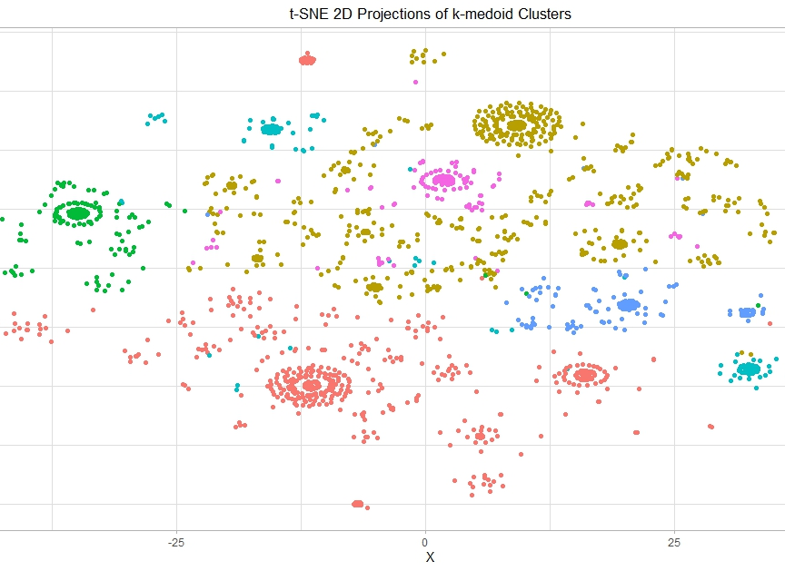
K-Medoids clustering on categories
Gower distance for categorical values
K = 6 obtained by silhouette maximization

Slide 10
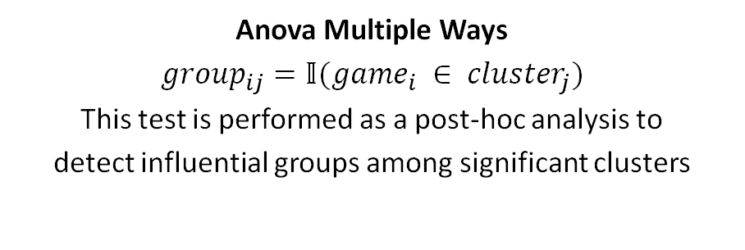
Response variables:
Average Rating
Average Complexity
1
Permutational Anova Scheme
Two-way Anova:
Clusters on categories
Clusters on mechanics
2
Anova Multiple Ways
$${group}_{ij}=𝕀({game}_{i} ∈ {cluster}_{j})$$
This test is performed as a post-hoc analysis to
detect influential groups among significant clusters
3

Slide 11
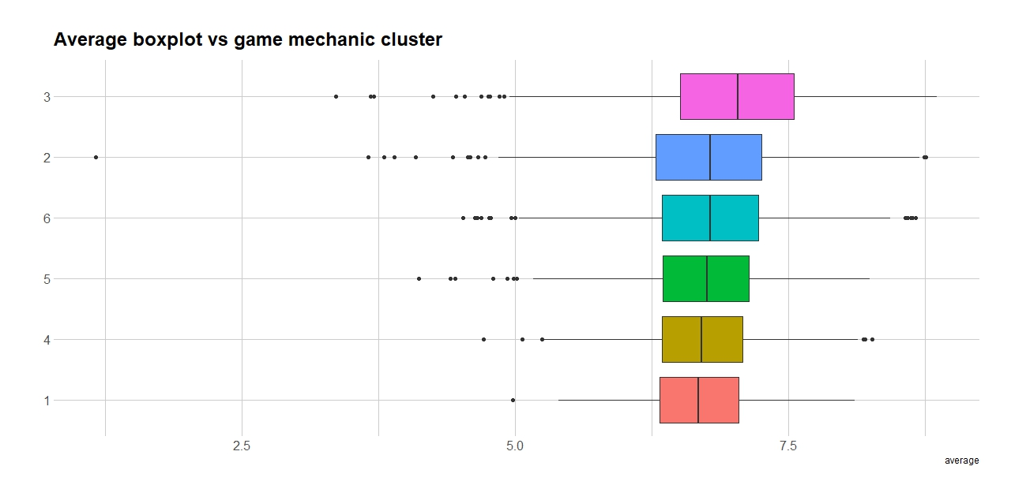
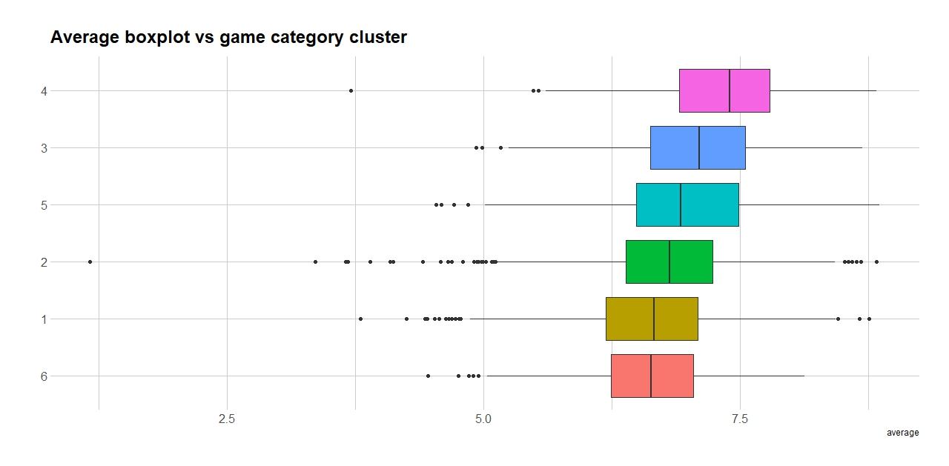
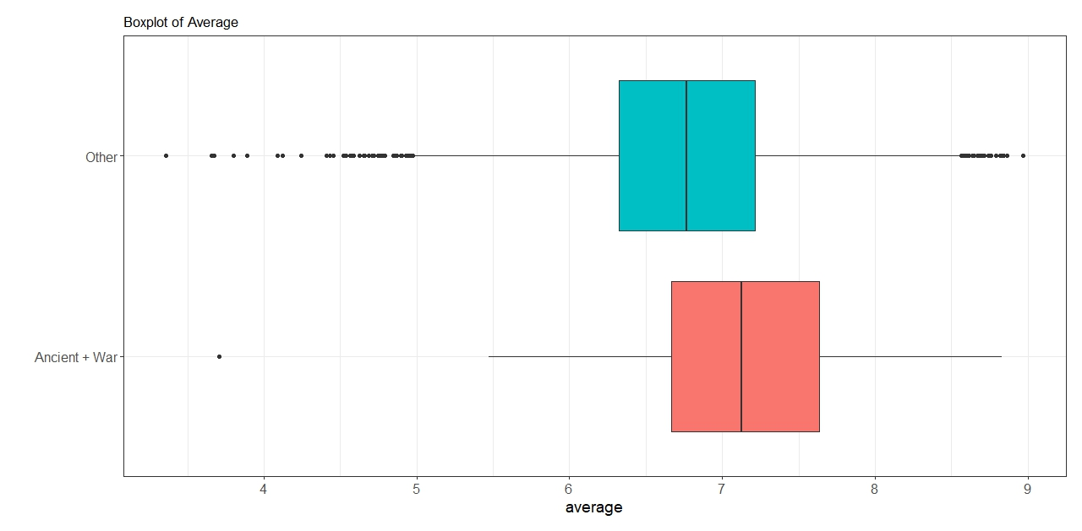
Permutational Anova: Average Rating
Categories are significant, Mechanics are not
War games, World War II and Ancient are the categories in the cluster with highest mean
The average rating is significantly higher for these categories (through anova one way)

Slide 12
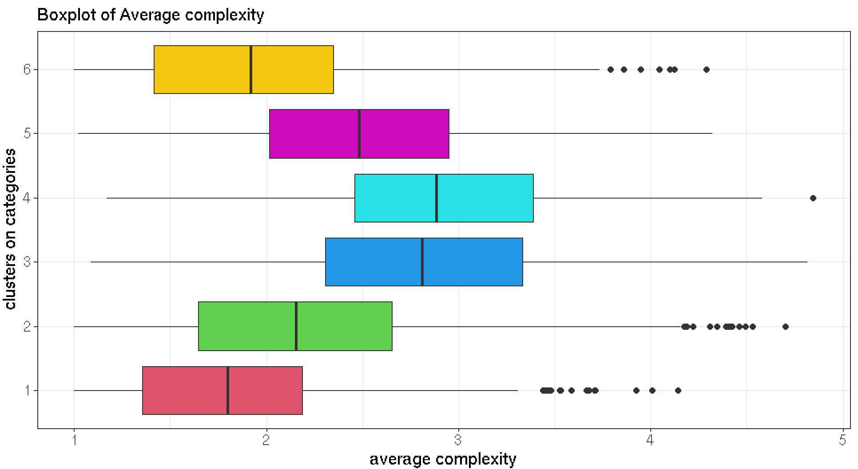
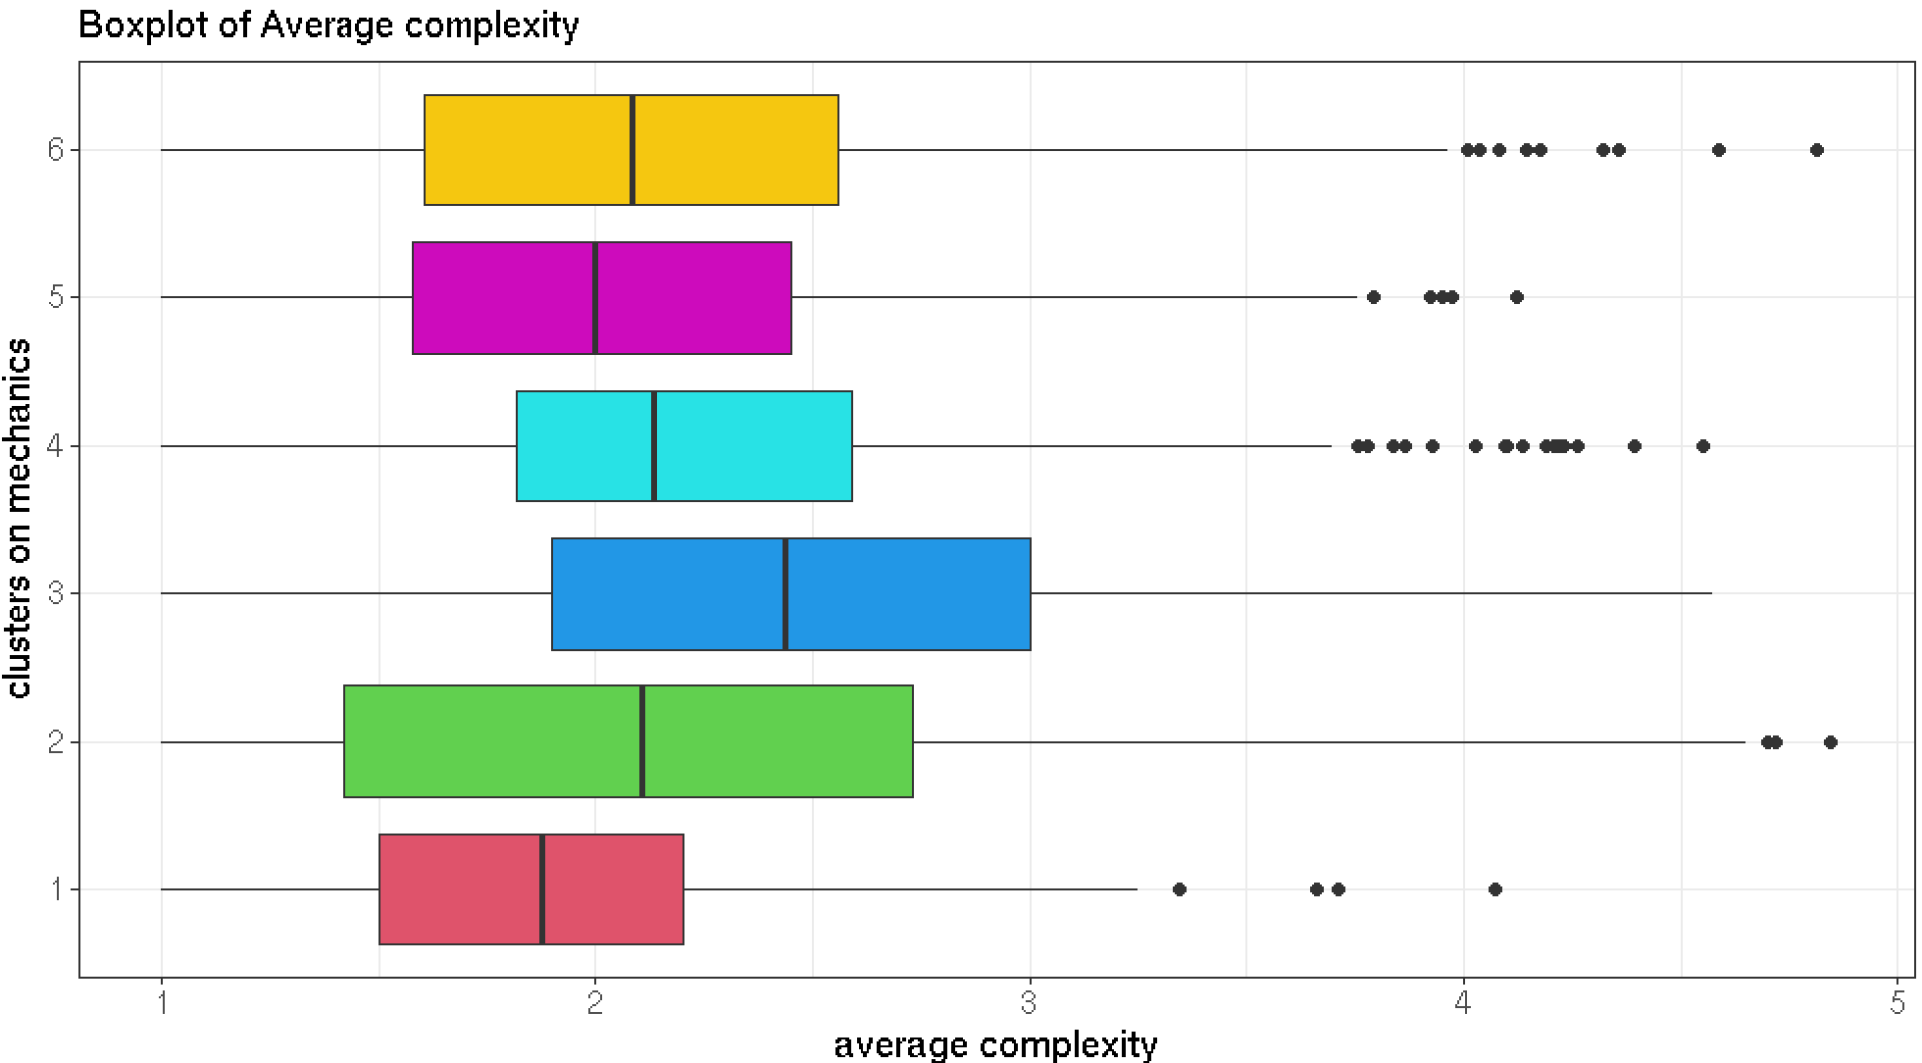
Permutational Anova: Average Complexity
Categories are significant, Mechanics are not
Third, fourth and fifth cluster have a positive contribution on the mean of the average complexity of the games
These clusters contain categories such as War games, Fantasy and Economics

Slide 13
https://unsplash.com/photos/Tizbbx-5esA
RESPONSE VARIABLE
MODELS
Average rating
Average complexity
GAM
LOCAL AVERAGING
COVARIATES
Playing time
Minimum age
Suggested number of players
Year
XGBOOST
PROBLEM SETTING

Slide 14




SHAP Value
The SHAP value is an estimate of how much each covariate influences the output of the model in correspondence of one input
Fit the model on every possible feature subset and compute the predictions for a datum $x_{0}$
MC of ${cov}_{i}$ is the difference between prediction of ${mod}_{j}$ and its version without ${cov}_{i}$
Each MC has weight
$$w_{f}={\left[f\left({F \atop f}\right)\right]}^{−1}$$
.
For each covariate, compute its Marginal Contribution (MC)
01
02
03
04

Slide 15
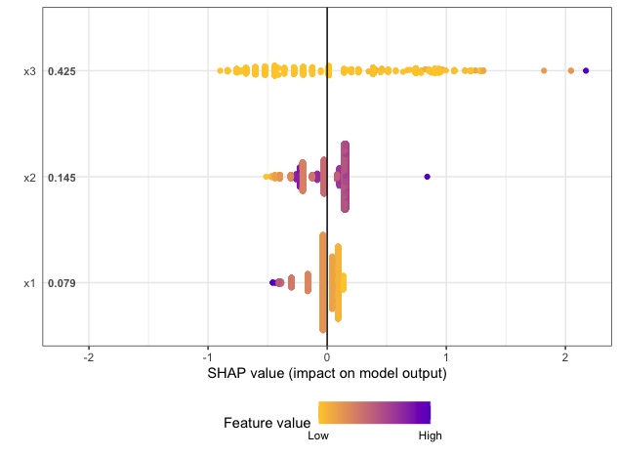
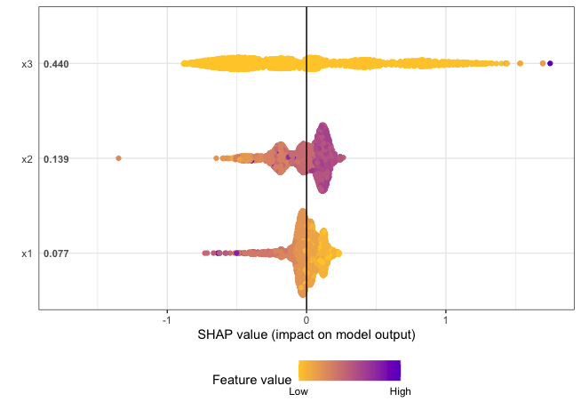

Regression Models for Average Complexity
GAM
XGBOOST
Covariates: playing time, minimum age, suggested number of players, clusters on categories
Covariates: playing time, minimum age, suggested number of players
$$R_{adj}^{2}=75\%$$
Test error = 0.42
Training error = 0.397991
Test error = 0.41

Slide 16
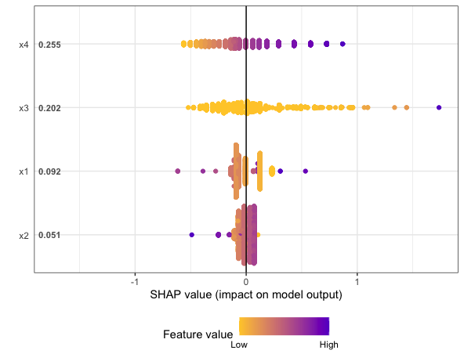
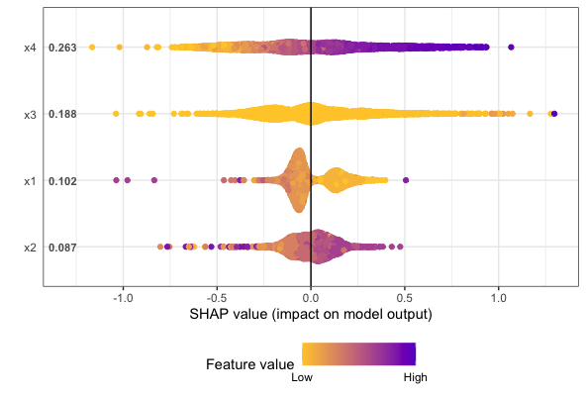

Regression Models for Average Rating
GAM
XGBOOST
Covariates: year, playing time, suggested number of players, minimum age
Covariates: year, playing time, suggested number of players, minimum age
$$R_{adj}^{2}=47\%$$
Test error = 0.51
Training error = 0.44
Test error = 0.51

Slide 17
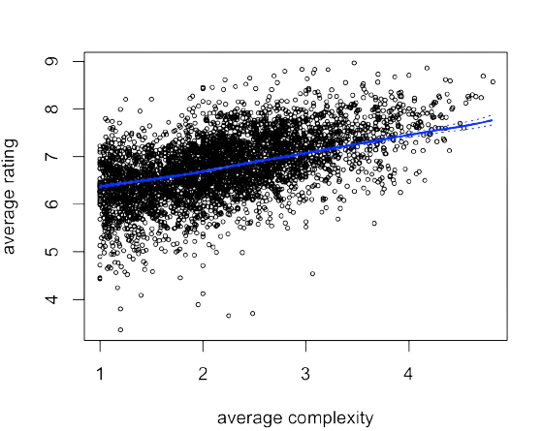
https://unsplash.com/photos/Tizbbx-5esA
Regression Models for average Rating
LOCAL AVERAGING
Covariate: average complexity
Epanechnikov kernel with bandwith equal to 0.5 (comparable with robust variance of the covariate)
Test error: 0.59
PROBLEM SETTING

Slide 18
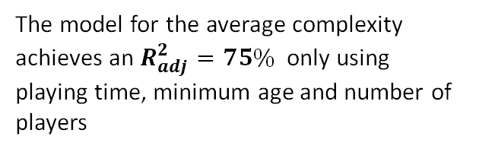
Categories like War games are associated with a higher average rating
01
We manage to explain both average rating and complexity through the characteristics of the game by means of Generalized Additive Models
02
Conclusions
The test error of the model for the average rating is still 0.5 and could be improved
03
The model for the average complexity achieves an $R_{adj}^{2}=75\%$ only using playing time, minimum age and number of players
04

